Slide 1

Your application, guided by someone who has been there.
Thank you for reaching out. This guide walks you through who we are, what we offer, and how to get started so you can make the most of the support you have asked for.
Real guidance. Shared journeys.
1/10

Slide 2
WHO WE ARE
We built TAL because we needed it and it did not exist.
The Application Lab was founded in 2025 by people who went through competitive international applications with almost no support. It was not just the paperwork. The confusion about what selectors actually want, the hours spent second guessing yourself, the feeling that everyone else somehow knew something you did not. We wanted to build something we wished had existed when we were applying.
"The problem is not that students lack ability. It is that the right guidance has never reached the right people. We are trying to change that, one application at a time."
THE FOUNDERS, CAMBRIDGE 2025
Two people who applied with almost no support, and built the guide they wished they'd had.
2/10

Slide 3
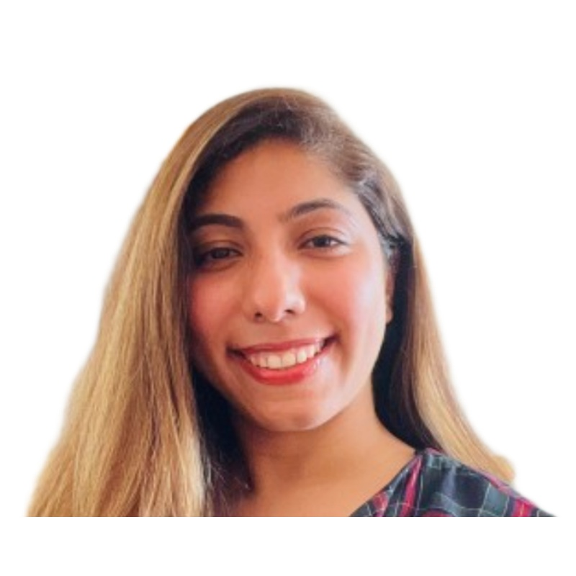
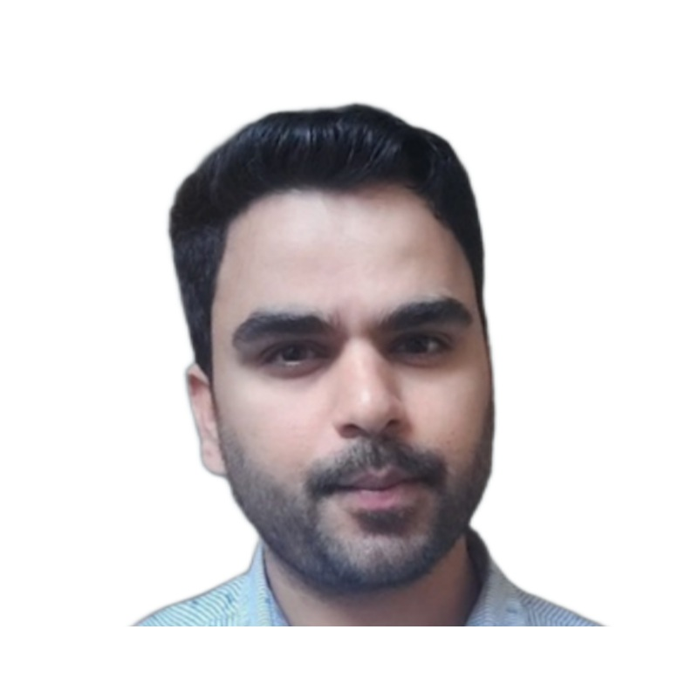
OUR FOUNDERS
People who have walked this path themselves.
Dr Kanupriya Sharma
Vishal Narula
CO-FOUNDER
CO-FOUNDER
PhD & MPhil in Criminology at Cambridge as a Gates Cambridge Scholar. Nigel Walker Prize (2026). Postdoctoral research fellow on a Leverhulme-funded project at Nottingham, endorsed under the UK Global Talent Visa (UKRI Route 3).
MPhil in Engineering for Sustainable Development at Cambridge as a GREAT Cambridge and Cambridge Trust Scholar. Shortlisted for Chevening and the Commonwealth Shared Scholarship. Recognised as a UK Tech Nation Global Talent.
Gates Cambridge Scholar
PhD Cambridge
GREAT Cambridge Scholar
MPhil Cambridge
Nigel Walker Prize 2026
UK Global Talent
UK Tech Nation Talent
3/10

Slide 4
OUR IMPACT
Results our mentees can point to.
£2m+
in scholarships secured, and counting
150+
3,000+
94%
mentors globally
applicants supported
success rate for 1:1 mentorship
OUR MENTEES HAVE WON PLACES AND FUNDING THROUGH
Chevening
Commonwealth Scholarships
Gates Cambridge
Mastercard Foundation
Erasmus Mundus
AND GONE ON TO STUDY AT
Cambridge
Oxford
King's College London
UCL
Edinburgh
LSE
Toronto
Melbourne
NUS
Stanford
SciencesPo
NYU
4/10

Slide 5
HOW IT WORKS
Simple, personal, and no guesswork.
From your first enquiry to your initial session, the process is designed to be seamless and efficient. Here is what you can expect.
01
We look at your interest form
02
We match you with a mentor
Based on your target programme or scholarship, your timeline, and what you need most help with, we figure out the right package and mentor for where you are right now.
We match you with a mentor who has been through the exact application you are preparing for — often the same scholarship, the same institutions.
03
Two free calls first
04
Your sessions, on your schedule
Before any session begins, you will have a 20-minute discovery call with our team, then a 20-minute introduction call with your matched mentor. Only once you are comfortable do we move forward.
Sessions are 60 minutes, conducted online, and arranged directly with your mentor. How you use each session is entirely up to you.
5/10

Slide 6
WHY TAL
Free mentorship isn't always sustainable. Expensive mentorship isn't always accessible.
TAL is designed to provide mentorship that is affordable, dependable and delivered by mentors who have walked the path — a modest fee creates commitment, mentors stay engaged, and support costs a fraction of traditional consultancies.
 | Free Communities | Traditional Consultancies | Premium Consultancies | TAL
Cost | Free | Moderate | High (above £1,000) | Affordable (£54.99/hr)
Personalisation | Inconsistent | Limited | High | High
Mentors | Volunteer-based | Consultants | Professional consultants | Peers who've achieved the same outcome
Incentives | Volunteer availability | Often commission-driven | Client fees | Student outcomes
Continuity | Can be inconsistent | Transactional | High | End-to-end support
Technology | Limited | Limited | Limited | AI-powered platform + community + mentors
6/10

Slide 7
SERVICE 01
Lab Focus — one to one live sessions with a mentor who has navigated your exact application
Each session is a 60 minute conversation with a mentor matched to your application. There are no set formats and no fixed agendas — you decide what you need from each session. Prefer it in writing? You can convert any single session into a written document review instead, as long as it is completed within 60 minutes.
Package | Price | Save | Best for | Valid for
1 session | £54.99 | — | One specific thing to work through right now | 30 days
2 sessions | £104.99 | 4.54% | A draft plus a follow-up round of feedback | 60 days
4 sessions ★ Most popular | £199.99 | 9.08% | Strategy, two rounds of feedback, and interview prep | 120 days
6 sessions | £289.99 | 12.11% | Thorough support from the beginning | 180 days
10 sessions | £469.99 | 14.53% | Multiple applications running at once | 12 months
Please note: session validity periods are strictly observed. Sessions not used within the validity window are forfeited — choose a package that matches your actual timeline.
7/10

Slide 8
SERVICE 02
Document Review — detailed written feedback with no live session required
Once you submit your documents, they are reviewed by a mentor who has gone through the same process. Within 7 working days you receive detailed, thoughtful feedback and clear direction on how to strengthen your next draft.
CV and Statement of Purpose or Personal Essay
£49.99
Both documents reviewed together — structure, content, and how well they speak to your target programme.
Returned within 7 working days
SCHOLARSHIP, WRITING SAMPLE AND RESEARCH PROPOSAL REVIEW
For major scholarship applications, your reviewer brings first-hand experience of the award itself — a nuanced understanding of selection criteria and common pitfalls.
Chevening
Gates Cambridge
Commonwealth
Rhodes
Fulbright & Fulbright Nehru
Inlaks Foundation
Erasmus Mundus
Weidenfeld Hoffmann
Mastercard Foundation
University scholarships
PhD research proposal
Writing sample
Pricing depends on the scholarship and the number of essays involved.
Write to us at info@theapplicationlab.com with the name of your scholarship, and we will confirm the cost.
8/10

Slide 9
OUR PROMISE
What you can expect from every TAL mentor.
1
2
They have been where you are
Honest, not just encouraging
Our mentors have navigated similar applications, often to the same scholarships and institutions, with journeys that closely reflect your own.
TAL mentors will tell you what actually needs to change, not just what sounds good. The most useful feedback is not always the most comfortable.
3
4
Reliable and responsive
We stay with you after your offer
Sessions are booked directly with your mentor. Document reviews come back within 7 working days. If something does not work, we sort it out.
Once you secure your place, you join the TAL peer and alumni network — and we hope you'll return as a mentor one day.
9/10

Slide 10
YOUR NEXT STEP
Ready to get started?
Book a free discovery call and we will confirm your mentor match. It only takes 20 minutes.
Book Your Free Discovery Call
Have questions first? Email us at info@theapplicationlab.com
Website: www.theapplicationlab.com
LinkedIn: linkedin.com/company/theapplicationlab
Instagram: instagram.com/theapplicationlab
YouTube: youtube.com/@TheApplicationLab
THE APPLICATION LAB · 2026 Edspire Labs Ltd · Company No. 16751243 · Cambridge, UK
10/10

